Slide 1
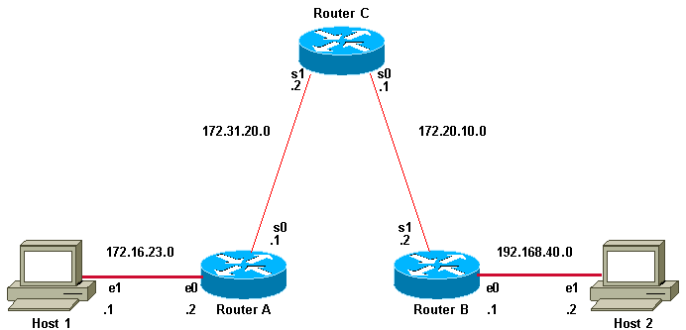
DATA COMMUNICATION AND NETWORKING- LAB
ZERO LECTURE
CAP-276

Slide 2
Text Books:
1. NETWORKING: THE COMPLETE REFERENCE by CRAIG ZACKER, Mc Graw Hill Education
References:
1. PACKET TRACER NETWORK SIMULATOR by JESIN A, PACKT PUBLISHING

Slide 3

Course detail:
L T P of the course is 0 0 2 i.e 2 hours of Practical per week
3 Continuous Assessments in form of Offline assignments will be held in 3rd, 9th, and 12th week of the term.
End Term Exam will be held after week 14.

Slide 4
Course Assessment
Assessment Criteria | Weightage
Attendance | 5%
CA | 45%
End Term Exam | 50%
Total | 100%

Slide 5
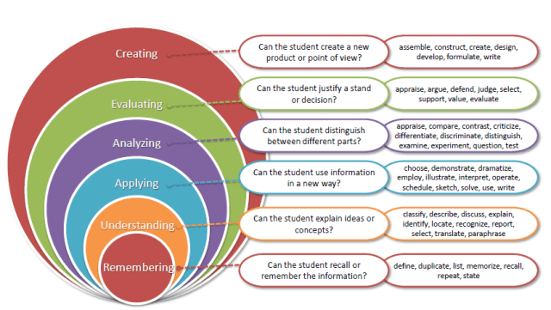
Revised Bloom’s Taxonomy

Slide 6
Course Outcomes:
Understand the fundamental concepts of data flow and criteria for the selection of transmission media.
Demonstrate the techniques for IP allocation in the networks and creation of the subnets.
Contrast between static and dynamic routing protocols
Summarize the working of various application layer services in the network

Slide 7
Program Outcomes:
PO1 Analysis & design of complex problems::Ability to apply knowledge of computer science concepts, principles & techniques to solve various computing problems.
PO2 Societal Impact::Acquire and apply advanced knowledge of concepts and participate in sustainable development.
PO3 Modern tool usage::Ability to use the modern programming languages, tools, techniques and skills necessary for design, develop and deploy software based applications.
PO4 Domain Knowledge::Ability to apply exploration to study and analyze problems in different areas of information technology.
PO5 Professionalism:: Ability to Manage time well, demonstrate an appropriate level of preparedness and maintain a high standard for personal and professional demeanor, accepting responsibility and accountability for words and actions
PO6 Research Problem Solving::Ability to assimilate, evaluate and present research results objectively
PO7 Employability::Ability to get employment opportunities in corporate/government/private sectors or to be a successful entrepreneur

Slide 8
Program Specific Outcomes
Sr. No | PSO | Outcome Specification
1 | PSO1 | Ability to analyze, interpret and present findings effectively using mathematical and communication skills.
2 | PSO2 | Understand the fundamentals and applications of programming, data structures, databases, networking, mobile computing, information security and data analysis.
3 | PSO3 | Amalgamate knowledge of information technology and computational tools for simulation.
4 | PSO4 | Ability to effectively apply the computer science concepts to analyze, design and develop cost effective, efficient and secure solutions to the societal problems.

Slide 9
List of Practicals / Experiments
Networking basics
demonstration of packet tracer installation and packet tracer interface
design a peer-to-peer network using the packet tracer, check the connectivity using ping command, sending PDU in real time mode and simulation mode
design two isolated networks in packet tracer to demonstrate the difference in working of hub and switch
design a network with hybrid topology that includes a bus backbone and three star networks, check the connectivity using ping command, sending PDU in real time mode and simulation mode

Slide 10
Connectivity between networks and routing
connect two networks using a single router and configure the router for communication between the two networks
connect two or more networks with a router in each network and configure the routers for static routing
connect two or more networks with a router in each network and configure the routers for dynamic routing using RIP
use static routing to connect the subnets of a network assigned with the following network 197.34.21.0/24, use FLSM to divide the network into subnet where every subnet supports at least 56 hosts

Slide 11
Configuring network services
configure HTTP server and demonstrate the process to access a website using IP address in real time and simulation mode
configure DNS server for two domain names with two HTTP servers in the networks and demonstrate the process to access both the servers using name resolution in real time and simulation mode
configure DHCP server and demonstrate how DHCP server assigns dynamic IP addresses to the nodes in local network
configure DHCP server and demonstrate how DHCP server assigns dynamic IP addresses to the nodes in some other network
configure the FTP server and demonstrate the working of FTP in real time and simulation mode
configure two e-mail servers with different domain names and with at least four users in each domain, demonstrate the process of sending and receiving e-mail messages in real time and simulation mode

Slide 12
Networks

Slide 13
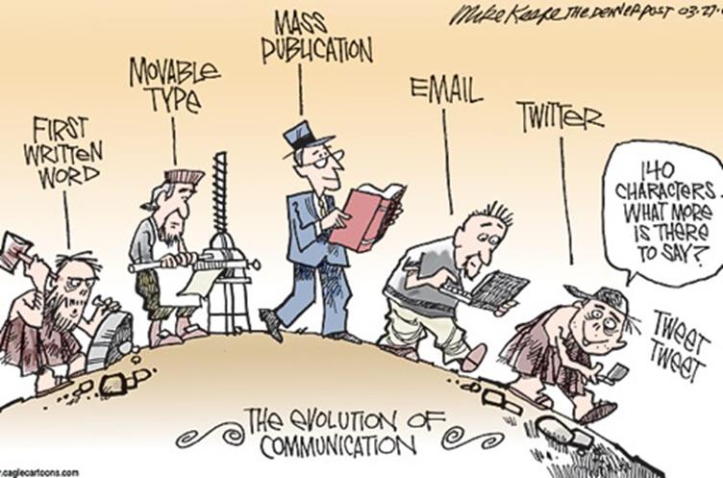

Slide 14

Social Network
Notes:
Social networks link people according to various social relationships, like acquaintance, friendship, collaboration, and sexual relation.
Social networks has been extensively used to measure the social standing of people participating in the network.
The interpersonal directed links in a social network are interpreted as input-output channels for the transmission of influence, and the possibly negative weight of links captures the endorsement strength between individuals.

Slide 15
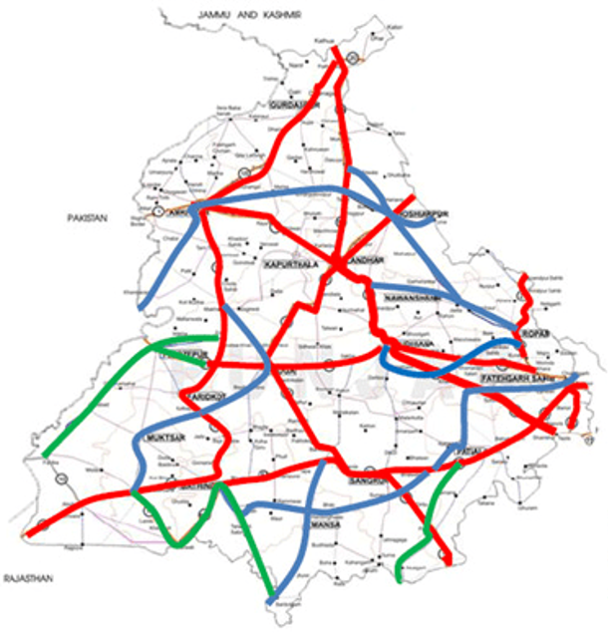
Road Networks

Slide 16
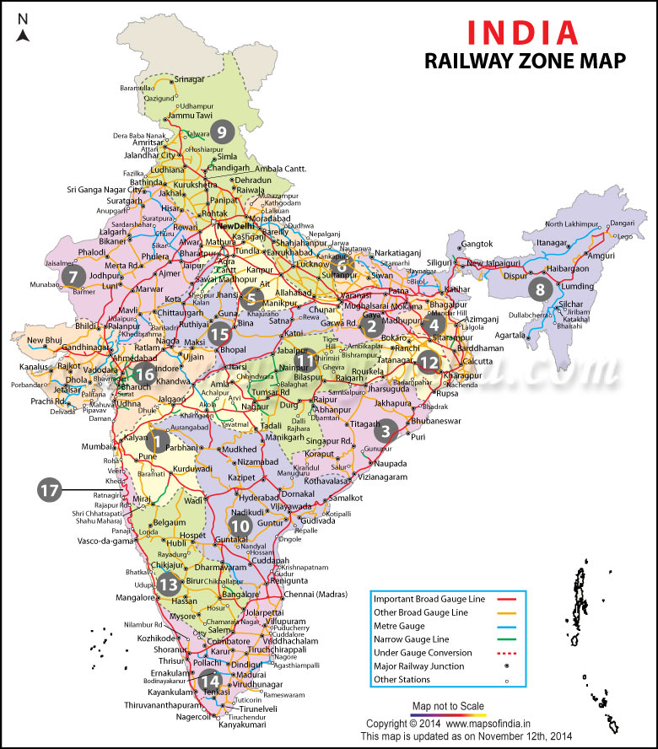
Railways Networks

Slide 17
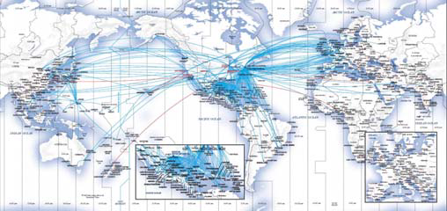
Air Transport Networks

Slide 18
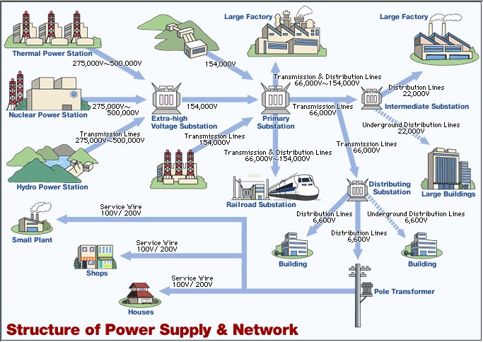
Power Distribution Network

Slide 19
Why to Learn Data Communication & Computer Network?
A system of interconnected computers and computerized peripherals such as printers is called computer network.
This interconnection among computers facilitates information sharing among them. Computers may connect to each other by either wired or wireless media.
Networking engineering is a complicated task, which involves software, firmware, chip level engineering, hardware, and electric pulses.
To ease network engineering, the whole networking concept is divided into multiple layers.
Each layer is involved in some particular task and is independent of all other layers.

Slide 20
Applications of Communication & Computer Network
Computer systems and peripherals are connected to form a network. They provide numerous advantages:
Resource sharing such as printers and storage devices
Exchange of information by means of e-Mails and FTP
Information sharing by using Web or Internet
Interaction with other users using dynamic web pages
IP phones
Video conferences
Parallel computing
Instant messaging

Slide 21
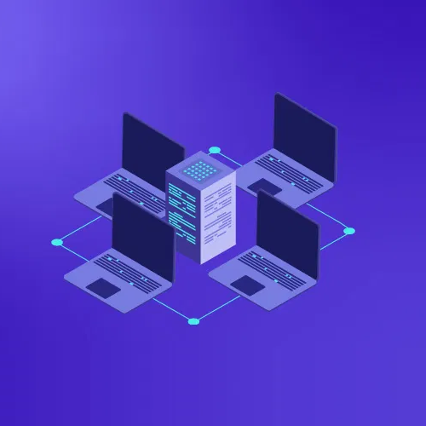
Why Cisco Packet Tracing is important
Packet Tracer offers an effective, interactive environment for learning networking concepts and protocols.
Cisco Packet Tracer as the name suggests, is a tool built by Cisco. This tool provides a network simulation to practice simple and complex networks.
s Cisco believes, the best way to learn about networking is to do it.
The main purpose of Cisco Packet Tracer is to help students learn the principles of networking with hands-on experience as well as develop Cisco technology specific skills.

